Slide 1
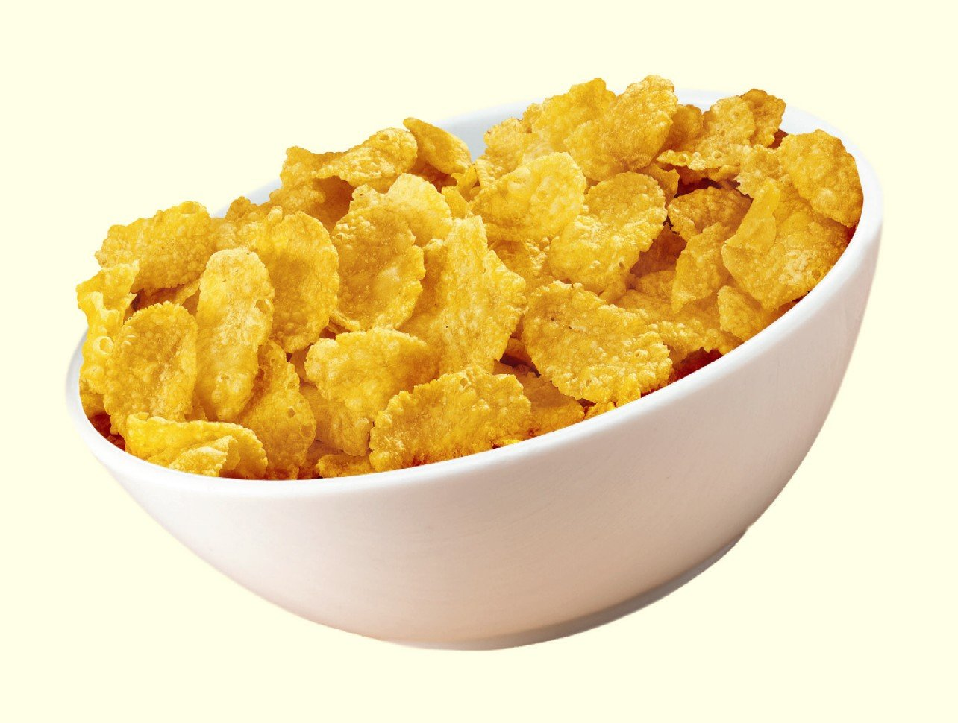
Kellogg Company (K)
Presented by
Kyra Kovacevich
Ryan Rochester
Ian Otto

Slide 2
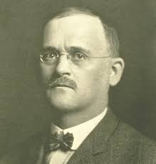
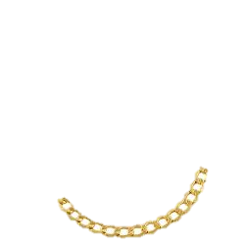
-History-
Founded February 19, 1906
Will Keith Kellogg
World Headquarters in Battle Creek
Departments Include: Finance, Marketing, Strategy, Management, Informational, Managerial Economics
Located in supermarkets such as Meijer's, Walmart, Hardings, etc.

Slide 3
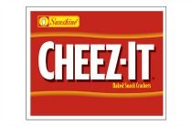
Locations
Products
Main Headquarters in Battle Creek
Geneva, Switzerland location of Snack Business Unit
Dublin, Ireland location of Cereal Business Unit
UK Headquarters in Manchester, UK
Latin America Headquarters Queretaro, Mexico

Slide 4
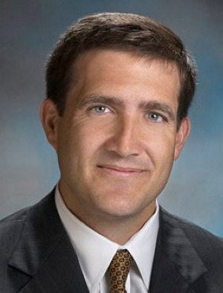
Mr. CEO
Been CEO since 2011
Joined Kellogg's in 1998
Lives in Kalamazoo, Michigan
Has six Children
Born in Australia
He has an MBA from Pennsylvania
John A. Bryant

Slide 5
-Board Of Directors-
John A Bryant
La June Montgomery
Donald R. Knauss
Stephanie Burns
Cynthia H. Milligan
Benjamin S. Carson
Mary Laschinger
Ann McLaughlin
John T. Dillon
Gordon Gund
James M. Jenness
Zachary Gund
Employee Number as of 2013: 30,277

Slide 6
Mission
“Every Kellogg Employee Contributes to the company mission and vision. Our growth and success have been made possible thanks to the commitment, creativity, enthusiasm, and hard work of our employees. Understanding how every action you take aligns with our company goals will insure we can achieve our vision for Kellogg and continue our mission.”
-Values-
To enrich and delight the world through foods and brands that matter.
Seek to continually simplify and improve processes procedures and activities.
Deal with people and issues directly and openly
-Social Responsibility-
BREAKFAST FOR BETTER DAYS, is a million dollar worth of grants to Health Kids Organization.
Manufacturing operations are working hard to produce energy use, greenhouse gas, water use, of food produced by 20%

Slide 7
SWOT
Strengths
Weaknesses
-Real Estate
-Financial Leverage
-Economies of Scale
-Technology
-Outdated Technology
-Weak Supply Chain
-Weak Management
-Customer Service
Opportunities
Threats
-Volatile Commodities
-Bad Economy
-Volatile Currencies
-International Competition
-Fragmented Market
-Financial Leverage
-Innovation
-Online Market
Curtesy of Wikiwealth.com

Slide 8
-Financials-
Financial Ratio | Math | % Ratio | Points
Profit Margin | 1807000/14792000 | 12.22% | 6
Debit Ratio | 11929000/15474000 | 77.09% | 0
Current Ratio | 3267000/3835000 | .85 | 0
Return on Assets | 1807000/15321500 | 11.79% | 6
Inventory Turnover | 8689000/15321500 | 6.65 | 2
Banks Affiliated With

Slide 9
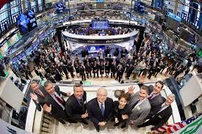
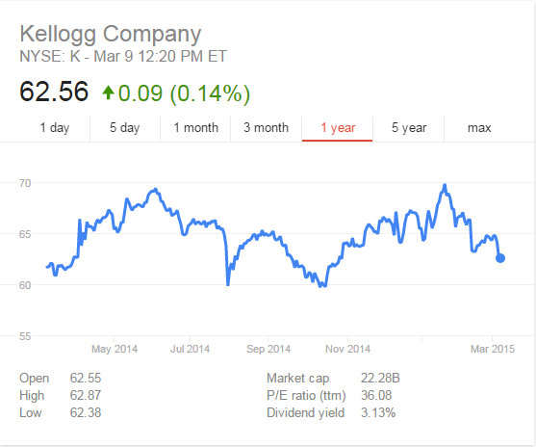
Market
NY
SE
New York Stock Exchange
Number of Shares on Market
Total Shares: 839,292
Current Price
Highest/Lowest Buy Price
Price/Earning

Slide 10
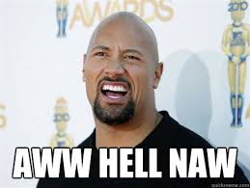
Would We Invest?
Terrible Debt Ratio
Low Score
Low Current Ratio

