Slide 1
Reading Reach
Literacy Program

Slide 2
How Does It Work?
Volunteers teach literacy classes at the library on weekday afternoons and evenings.
Classes contain between 8-12 students.
Students take classes according to their age group.
The library provides the teaching materials and a private room for the classes.

Slide 3
What Is Reading Reach?
Reading Reach is an all-volunteer organization that partners with the local library to teach reading skills to kids, teenagers, and adults.

Slide 4
Our Mission
Reading Reach’s mission is to give people of all ages the literacy tools they need for an independent, successful future.

Slide 5
Reading Reach
The Basics

Slide 6
Think About It
If you had trouble reading, you could not…
Drive a car
Pay bills
Shop for groceries
Use a computer
And so much more…

Slide 7
Volunteering Basics
All volunteers must commit to one afternoon or evening a week.
All volunteers go through a training session before they teach a class.
Lesson plans are provided for the volunteers.
All volunteers will undergo a background check.

Slide 8

Volunteer Testimonial
“It makes me feel good to know that the skills I am teaching others will help them get better jobs.”
  Erik, age 32

Slide 9
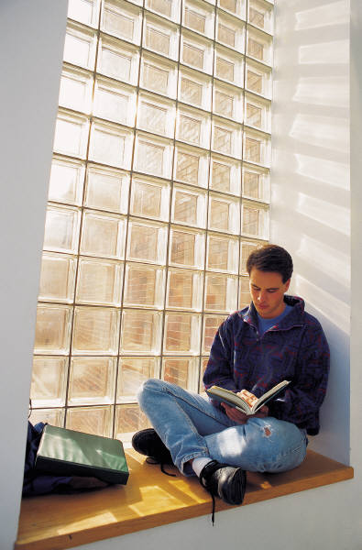
Student Testimonial
“Reading Reach helped me do better in school. Before, I hated books and reading. Now I’m an A student.”
  Steven, age 15

Slide 10
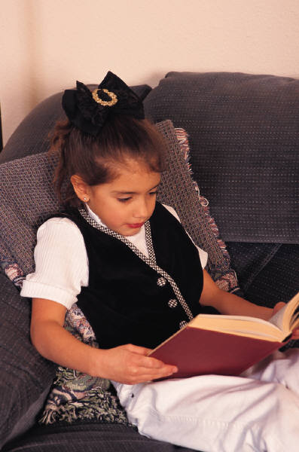
Student Testimonial
“Now I read to my parents, instead of them reading to me!”
  Sukee, age 8

Slide 11
How Do I Sign Up?
Simply stop by our booth after this presentation and fill out a form. One of our staff members will contact you in the next seven days.

Slide 12
Reading Reach
Volunteer Today!
Notes:
Ask if anyone has questions.

